Slide 1

By
Supriya Vallarapu
Chandana Joshi
Dharma Nimmala
Ankur Haritosh

Slide 2
Project Description
This project aims to build a Full Stack Web Application known as Incident Ninja. Incident Ninja is designed to help businesses improve their IT operations. The main idea behind the application is that it allows the user to raise an incident which will be assigned to the support team and the issue will be resolved which will get updated on the user side.
The application is designed to be highly interactive and user-friendly, with many features to ensure a seamless user experience. Some of these features include a user login and registration system, incident creation and management functionality, filtering options for incidents, alert functionality for meaningful feedback, and a dashboard page to display analytics for active and inactive data.

Slide 3
Features
User Management and Authentication: Allow users to sign up, create an account, and view their profile information.
Incident Management System: Enable users to create, view, edit, and delete Incidents for various issues, requests, or inquiries.
Filter & Search: Provide global filters and search functionality to help users find the incidents they need quickly.
Incident Details: Show detailed information about each Incident, including its status, priority, owner, history, comments.
Metrics & Analytics: Display charts and metrics on a dashboard to help track incidents and inactive data and make data-driven decisions.
Responsive Design: Create a user interface that adapts to different screen sizes, devices, and orientations to ensure a seamless experience for all users.

Slide 4
CONTRIBUTIONS
Supriya Vallarapu
Project Backend Setup with all layers
Dashboard Page creation and its UI
New Incident creation page and its UI
UI creation for Incident Management Page
Chandana Joshi
Chart Metrics
Incident Management Page
All Incidents View
CRUD Operations for Incident page
Dharma Nimmala
Sign Up, Login and Logout, Forgot Password
User Authentication
UI creation for Login and Signup Pages
UI creation for Incident information page
Ankur Haritosh
Filtering panes
Toggle Pane in incident Management
Incident Information page
CRUD Operations for Incident Information page

Slide 5
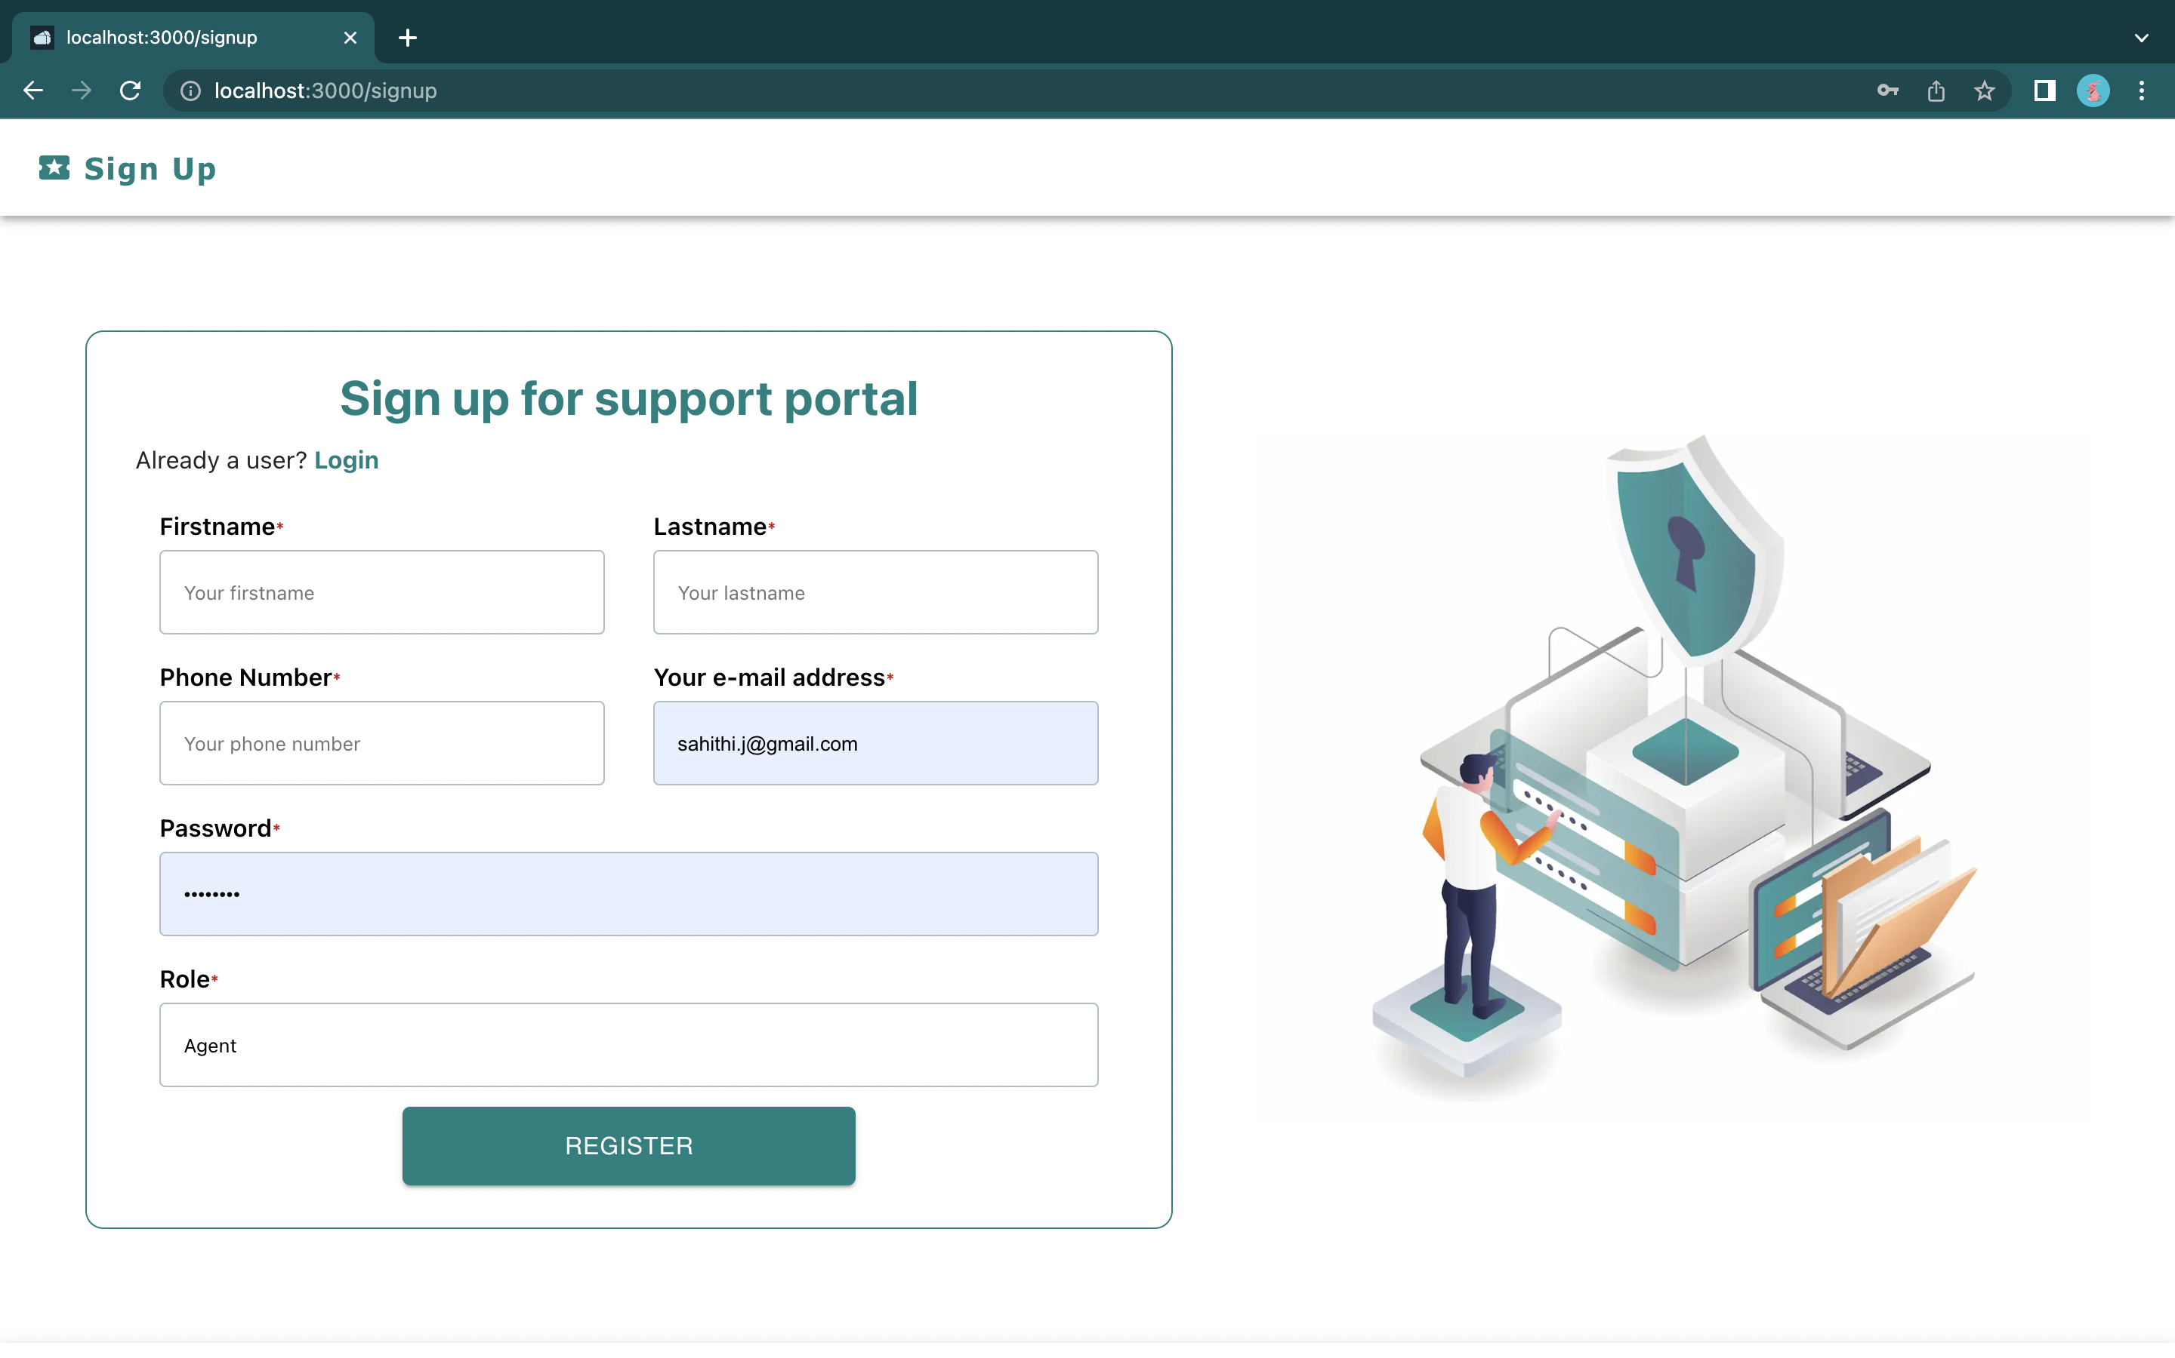
SIGN UP PAGE

Slide 6
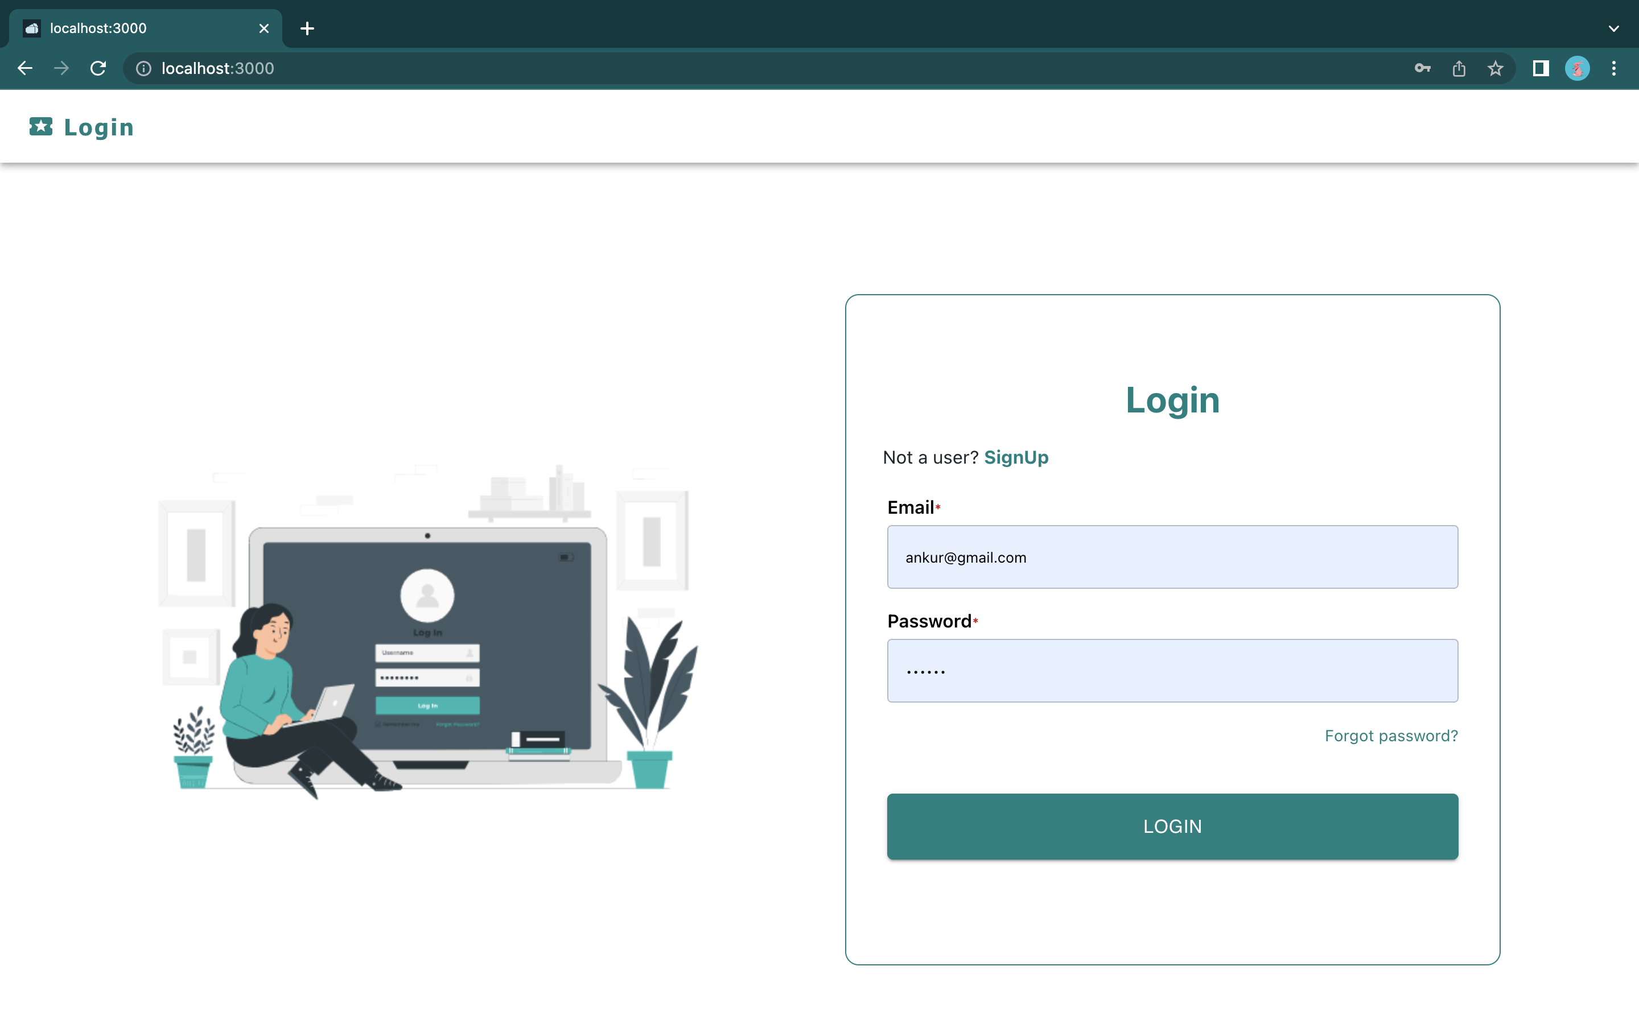
LOGIN PAGE

Slide 7
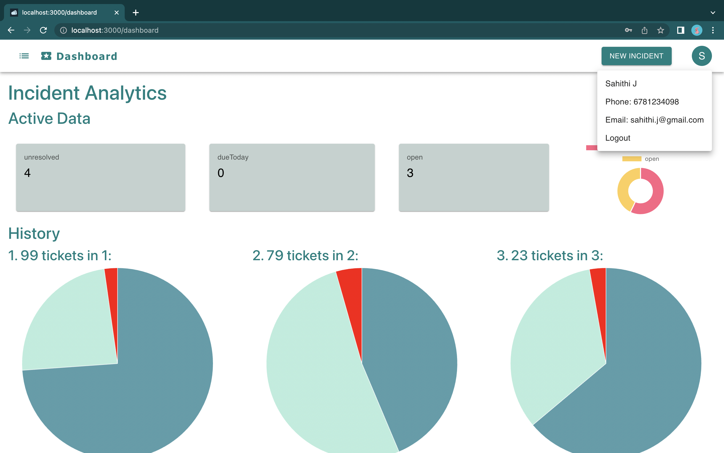
DASHBOARD PAGE

Slide 8
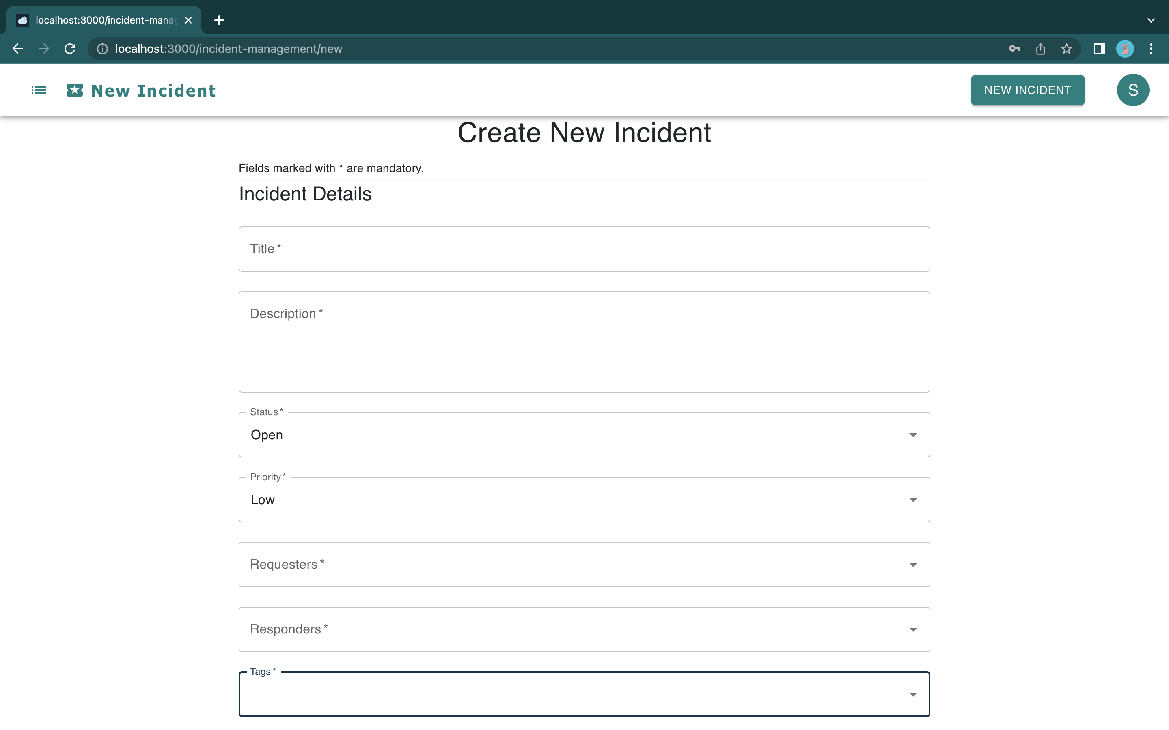
NEW INCIDENT PAGE

Slide 9
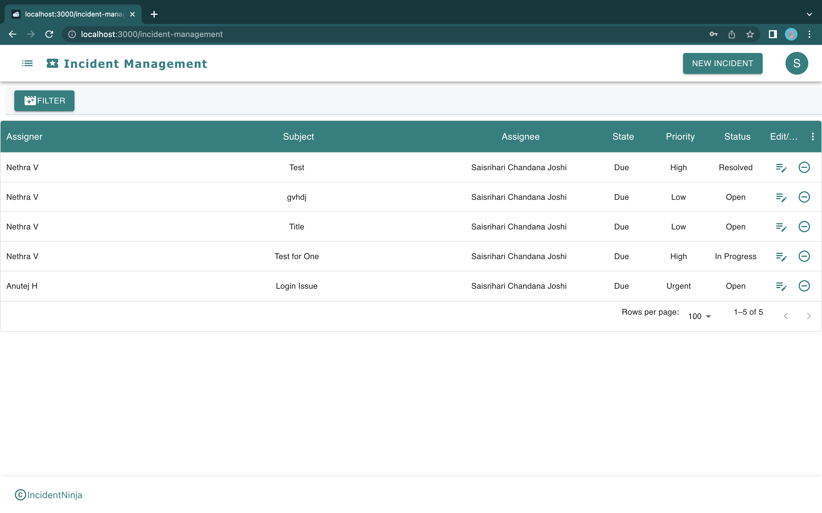
INCIDENT MANAGEMENT PAGE

Slide 10
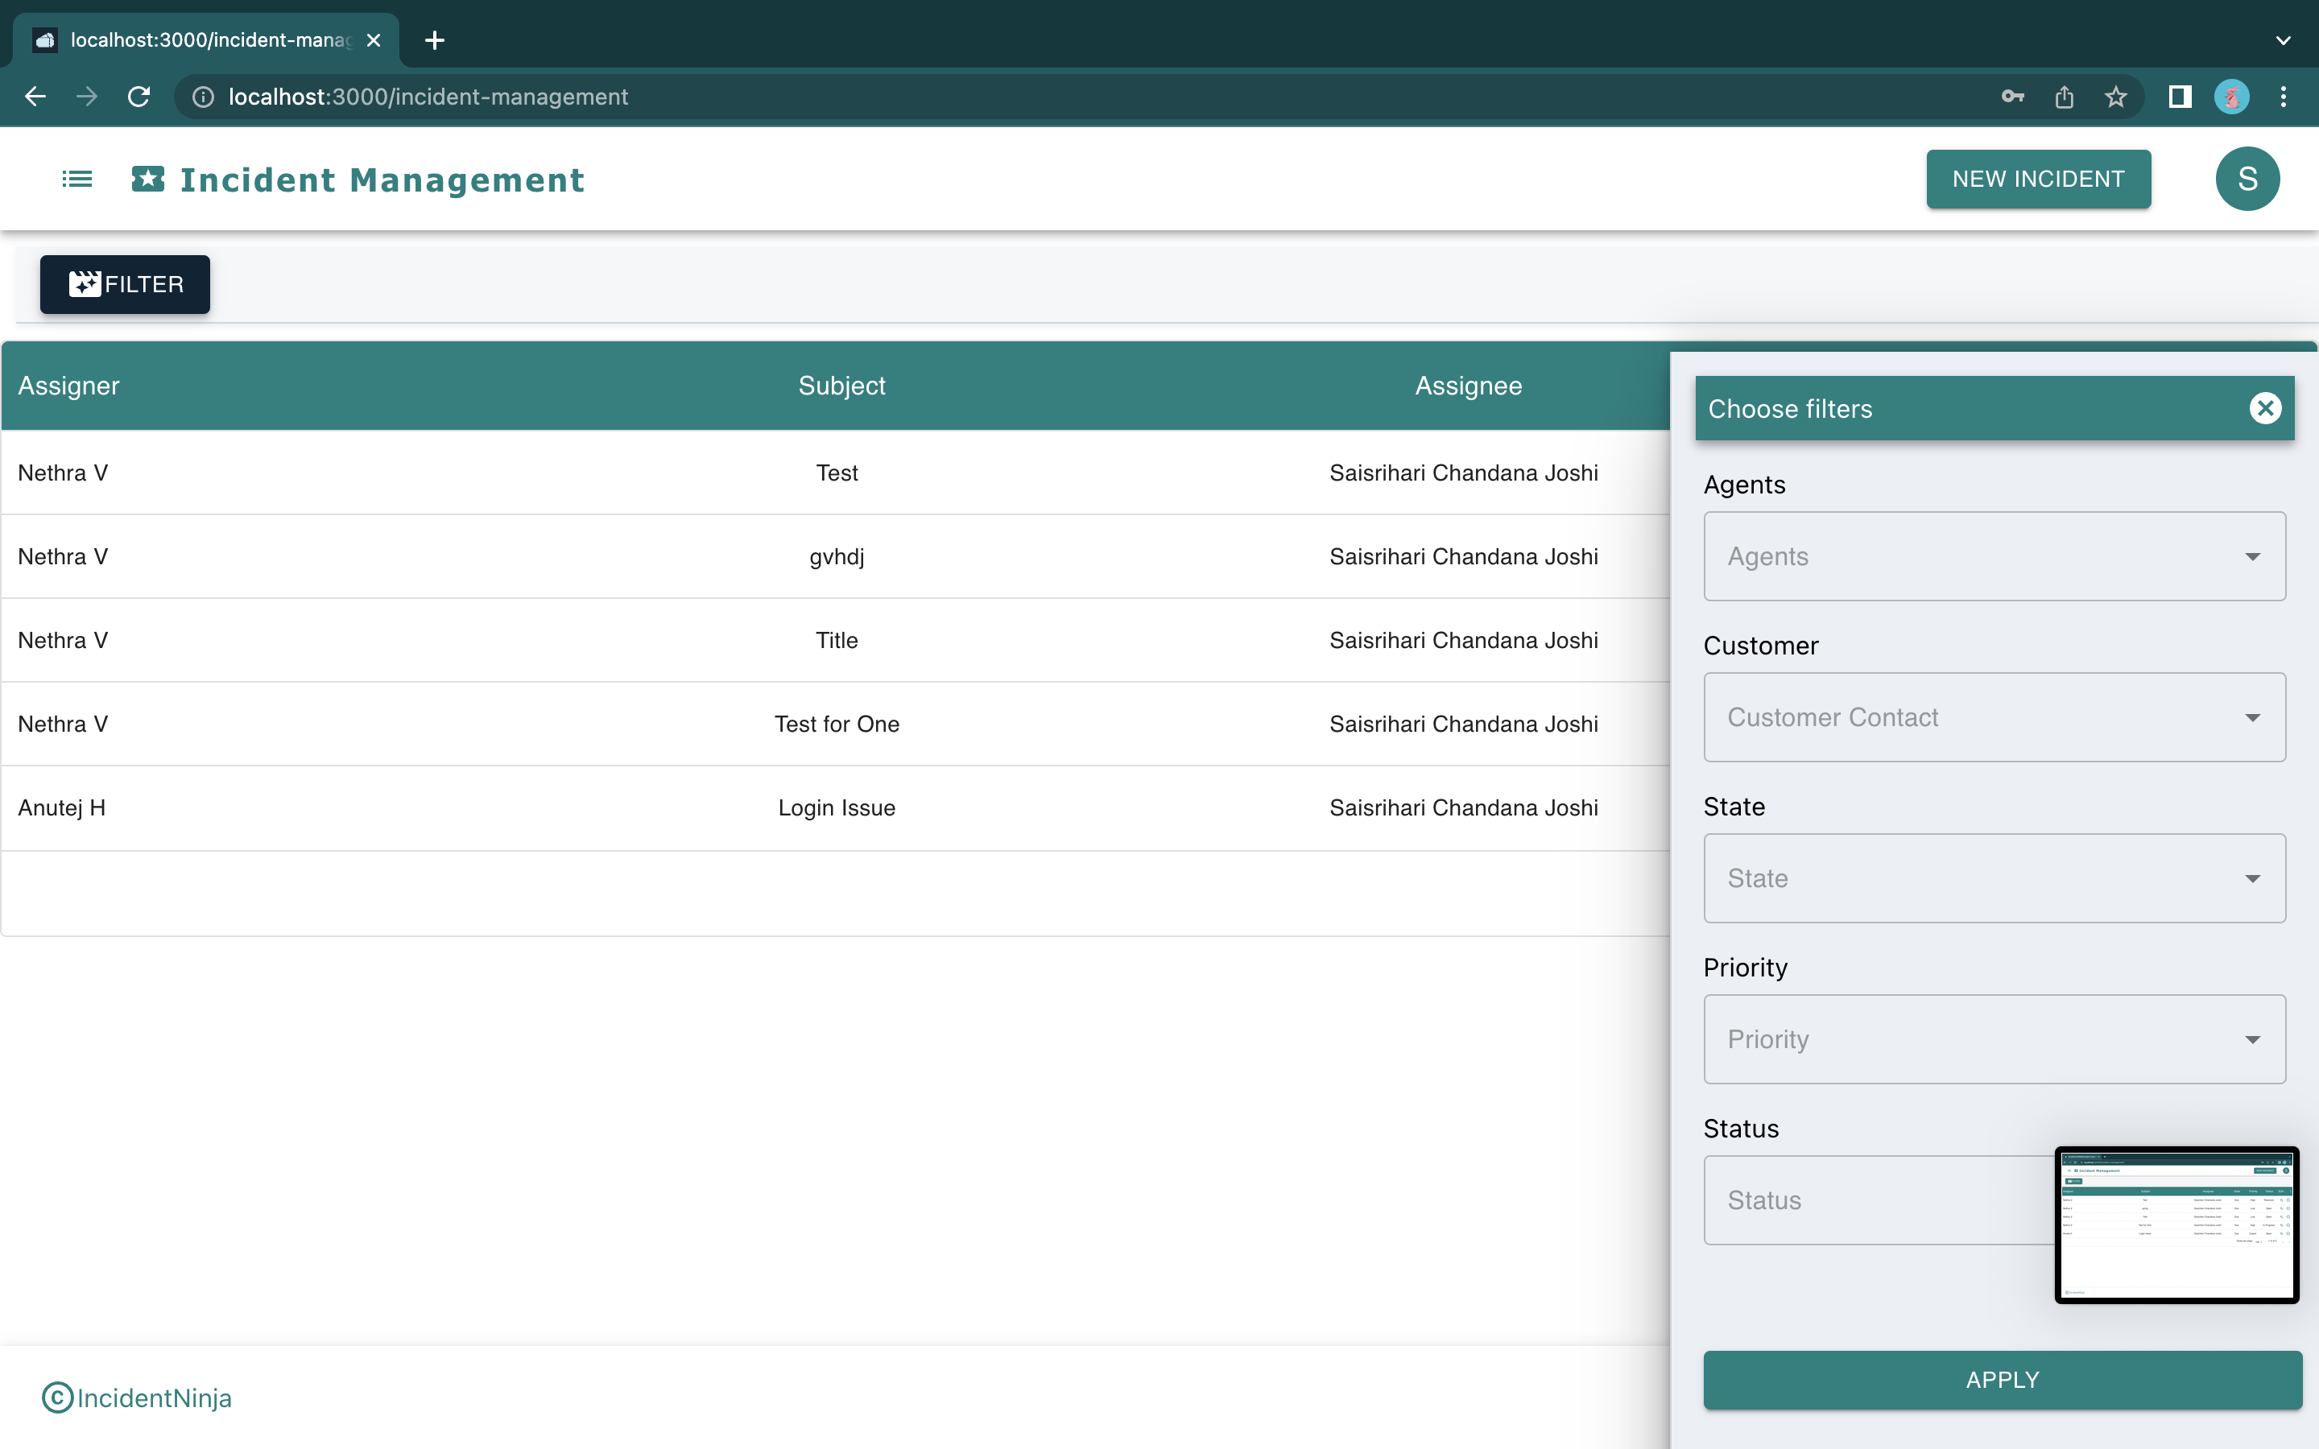
INCIDENT MANAGEMENT (FILTER OPTION PANE)

Slide 11
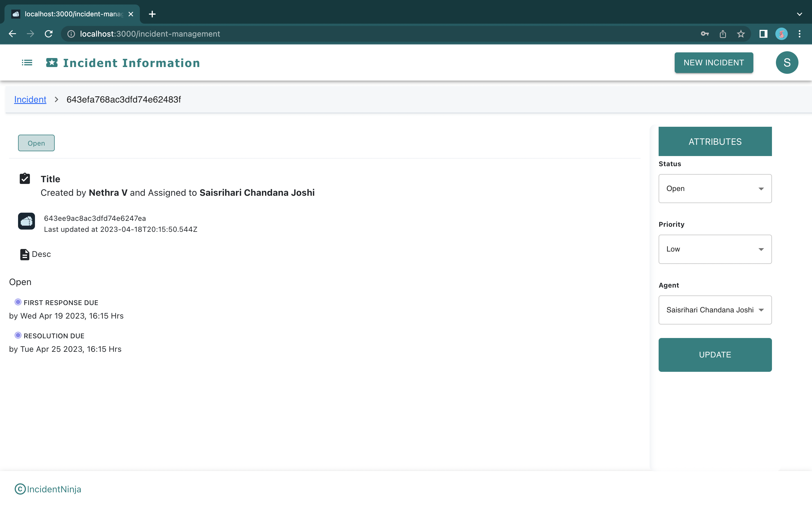
INCIDENT INFORMATION PAGE

Slide 12
THANK YOU

